Slide 1

Trauma Informed Parenting
Libby Bergman, LICSW
Family Enhancement Center
4826 Chicago Avenue, Suite 105
Minneapolis, MN 55417
(612) 827-3028
.

Slide 2

Family Enhancement Center
Center Founded 20 years ago
Committed to taking prevention action and treating the effects of child abuse.
Educational services for professionals, parents and community members geared to goal of prevention
Specialization in sexual abuse treatment and prevention
Notes:
Thanks much for inviting me to talk today. I hate to admit this, but there is little I like talking about more than child abuse. I know that sounds a little strange but whenever I am asked to talk about child abuse I feel hopeful that with more interest in this topic, we as a community will be able to take more actions to prevent child abuse and help those effected. Many things have changed much since we founded the Center 18 years ago. We understand better how to prevent abuse and how to treat it properly. There is much more hope now. We founded the Center with the goal of child abuse prevention.

Slide 3
Family Enhancement Center
Intensive services for children and their families provided by expert Staff who have training specific to work with children of all ages.
In Home Parent – Child Interaction Therapy.
Support Groups for parents.
Individual and family therapy for children and adults at risk for or affected by abuse.
Sexual abuse treatment program for children and their families.

Slide 4

Critical Pieces of the Trauma Informed puzzle
Engagement of parent
Parent’s understanding of trauma’s effect on the brain
The creation of a safe holding environment which ALWAYS includes a team of helpers.
Parent learning specific techniques to heal emotional regulation, make up gaps in learning and development and create relationship.

Slide 5

Parent Engagement

Slide 6

Engagement
Parents likely involved in creating trauma
They likely feel like a failure
Parents need reassurance.
Blame free zone
Guilt/Shame is not
your friend
Fact that can help them:
We are just learning now how trauma can effect young children.
No one plans to have their child effected by trauma.
Every one has trauma in their lives.

Slide 7

Engagement
Listening and listening……
Motivational Interviewing techniques can be helpful.
Accepting the ambivalence parents may feel. (List……)
Help them explore the opposite side.
Try to get to one long tern goal for their child or family in the first 4 sessions.
Notes:
Ambivalence: Maybe I should just give up. Maybe I can’t do this. Nothing will help. My child is damaged goods. If I change the way I am parenting, others will judge me. No matter what I do, it always turns out the same. If I give too much positive time, my child will be spoiled, not understand the real world, or feel like they are being rewarded for bad behavior.

Slide 8
Engagement
Empathy for the anger and frustration.
Family Worker - Therapist
Parent
Empathy
Parent
Child
Empathy
Notes:
Treating the parent as they should treat their child. Example: day-wetting parent and sentences.

Slide 9
Activity
Ambivalence

Slide 10

Engagement
Long term view.
Being available for crisis or making sure someone is.

Slide 11
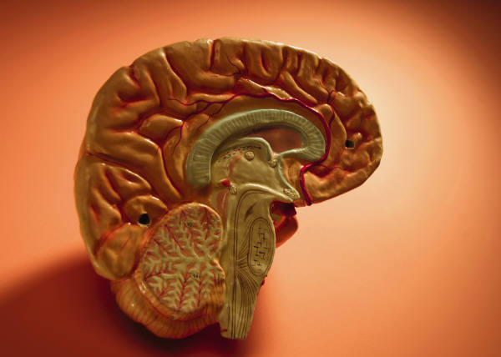
Understanding trauma’s effect on the brain

Slide 12
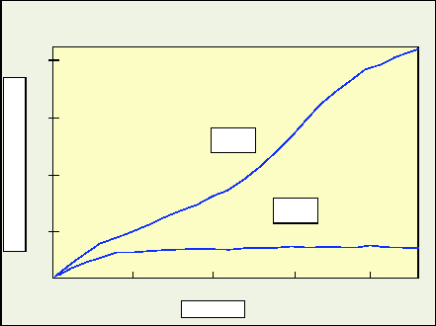
Brain and Body Growth
Multiples of Weight At Birth
Body
Brain
1 5 10 15 20
Age

Slide 13
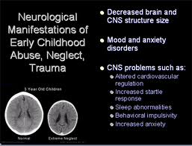
Brain Change

Slide 14
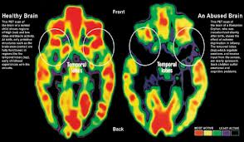
The Brain – Thinking About Trauma

Slide 15
Sequential Neurodevelopment
The brain is undeveloped at birth
The brain organizes from the "bottom" up - brainstem to cortex and from the inside out
Organization and functional capacity of neural systems is sequential
Experiences do not have equal "valence" throughout development
All rights reserved © 2010 Bruce D. Perry

Slide 16
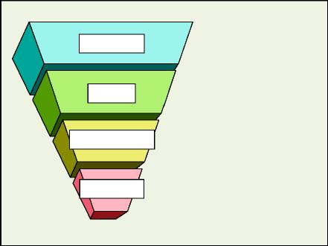
Bottom Up Development of the Human Brain
Abstract thought
Concrete Thought
Affiliation
"Attachment"
Sexual Behavior
Emotional Reactivity
"Arousal"
Appetite/Satiety
Motor Regulation
Blood Pressure
Heart Rate
Body Temperature
NeoCortex
Limbic
Diencephalon
Brainstem

Slide 17
Use Dependent Development
The more a neural system is
"activated," the more that system
changes to reflect that pattern of
activation
This is the basis for development,
memory and learning

Slide 18
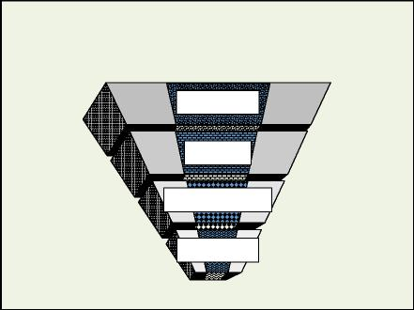
Brain of child effected by trauma or neglect
Neo Cortex
Limbic
Diencephalon
Brain Stem

Slide 19
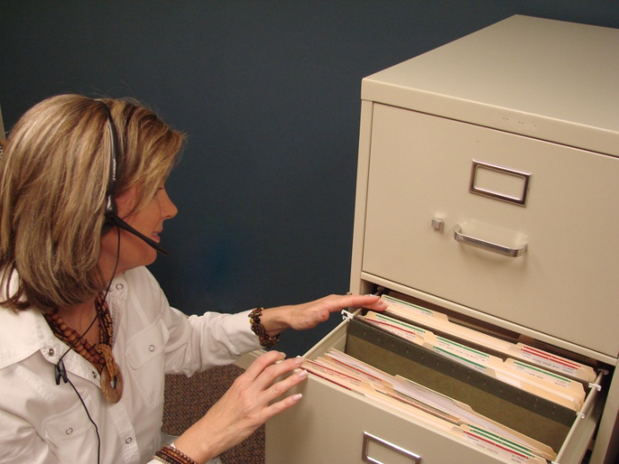
Implications of Brain Development
Early experiences have more weight
Framework on which all else is hung
Teeth Brushing – Automatic
File Cabinet

Slide 20
The Good News
The brain is much more changeable than previously thought
Early years – impact is major and small changes make a big difference
Adolescence presents a new opportunity.

Slide 21

Implications of Brain Development
Neuron connections develop through stimulation.
Growth does not occur unless the pathways are stimulated through interactions and experiences.
Areas with no stimulation are under-developed

Slide 22

Implications of Brain Development
Neural Pathways get worn into the brain like a running path get worn into the dirt.
Eventually - State becomes Trait

Slide 23
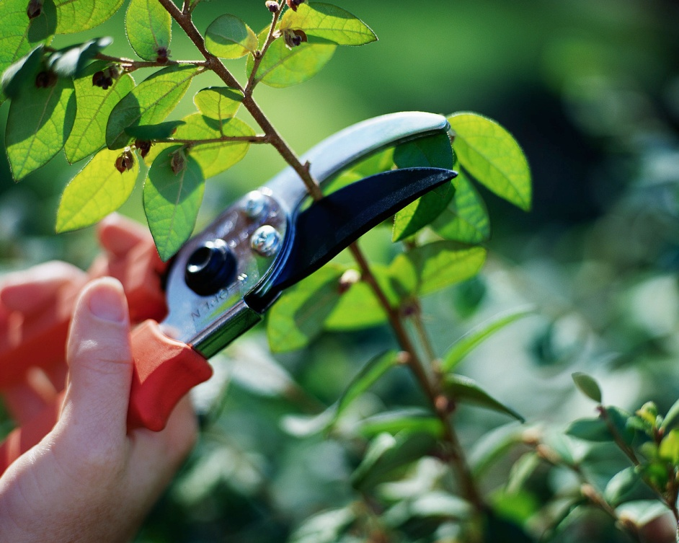
Implications of Brain Development
Adolescent brain experiences major changes until approximately age 25.
These changes are primarily in the pruning of neural pathways and thickening of the pathways.

Slide 24
Implications of Brain Development
Adolescent brain presents an opportunity to get rid of old pathways that are dysfunctional.
And thicken up healthy patterns.

Slide 25
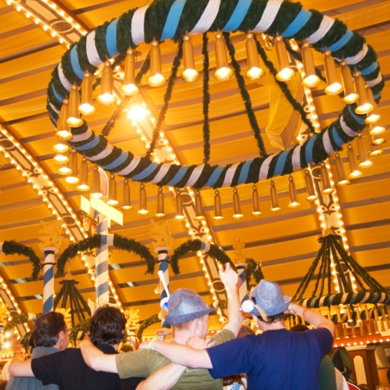
Practical Understanding of Child Trauma
Trauma can manifest in multiple ways. Three main areas of effect.
Relational
Regulation
Learning

Slide 26
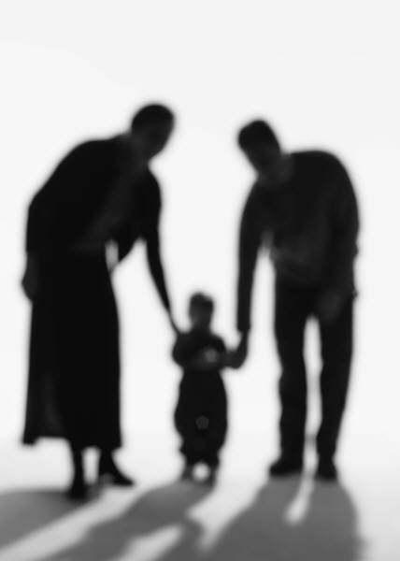
Holding Environment for Traumatized Children
.

Slide 27
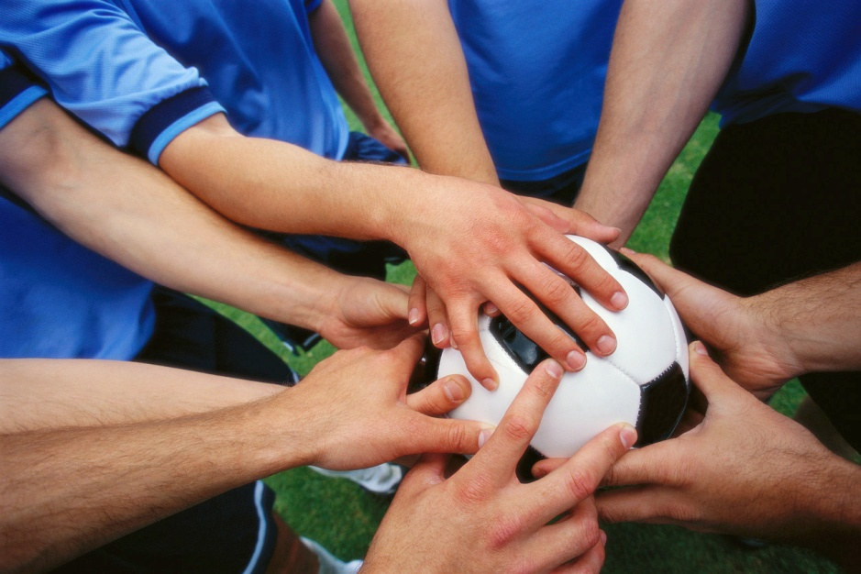
Holding Environment is the first priority - Team Development
In Home Parenting worker or family skills
Skills worker or PCA
Family members
Child Therapist
Parent Therapist
Psychiatrist
Medical Doctor
Neighbors
Friends

Slide 28
Team Development
Regular contacts between team members.
Who is the team leader? Parent and ???
Team meetings should include:
Child Therapist
In Home Parenting
Skills Workers - PCA
Extended family
Close friends
Written plans are good

Slide 29

Holding Environment is first priority
List situations or behaviors that require back up help.
List back up helpers.
Family group conference.

Slide 30

Holding Environment is first priority
Safety set up requires:
Room or space for time in or time out.
Locking up devices or dangerous items
List of actions not to be taken

Slide 31
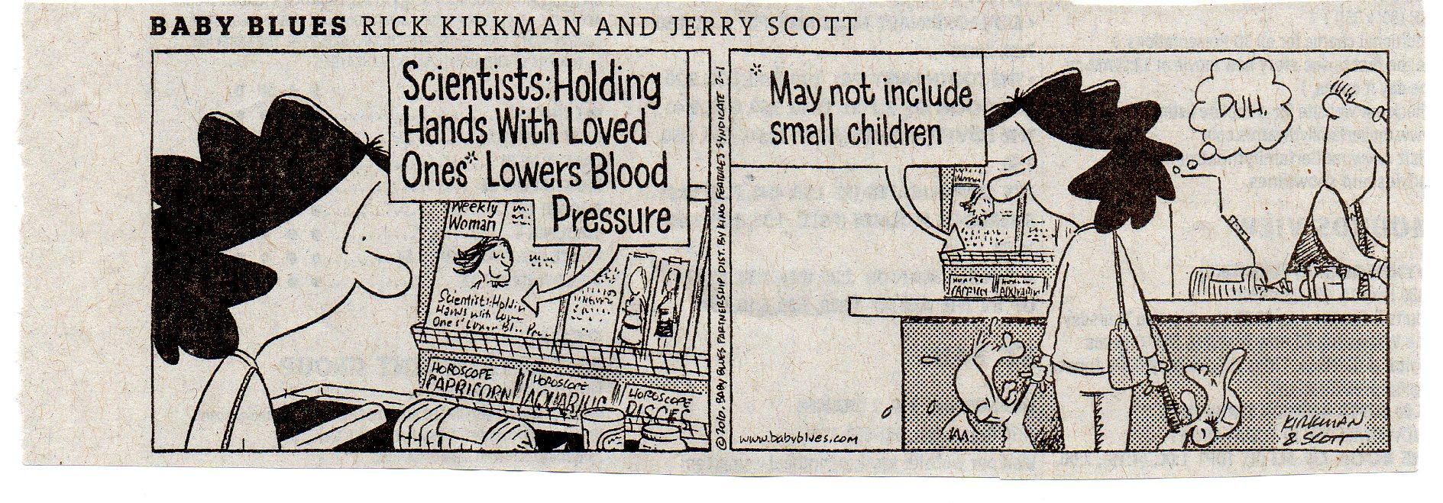
Humor is a must

Slide 32

Holding Environment includes consistent consequences
Consequences should be given for a small set of behaviors - usually safety related.
Consequences should be brief.
Consequences should be delivered in the same manner each time.

Slide 33
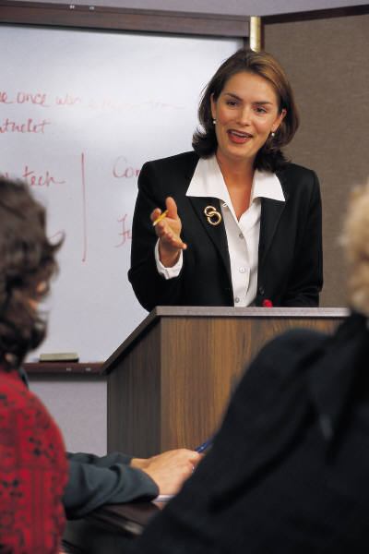
Holding Environment includes consistent consequences
Consequences should be delivered in a matter of fact manner with NO lecture.
For older children who are not in control– consequence should be given later or next day.

Slide 34

Holding Environment includes consistent consequences
As soon as consequence is accepted or completed, life goes back to the good place it started.
NO resentment or residual anger – fresh start.
Caregiver gets a fresh start too.

Slide 35


Holding Environment must be relentlessly positive
Belief that the child will succeed has major impact on their success.
Recognize children learn ONLY from making mistakes.

Slide 36

Holding Environment must be relentlessly positive
Observe and comment VERY regularly on the positives
Don’t use “good job” or “well done”
Be like a video tape machine; “I see you are taking the red marker out. You are coloring slowly and with attention to detail.”
Do not make judgments, “that is a good color”.
Use yourself; “I like pictures where there is a lot of red, it reminds me of fireworks,”.

Slide 37
Positive lectures - activity
Your non-judging reactions to neutral or positive behavior.
Be specific and detailed.

Slide 38


Techniques for Healing the Relationship
.

Slide 39


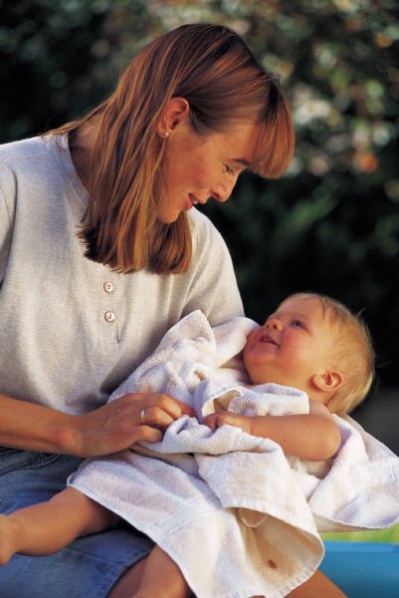
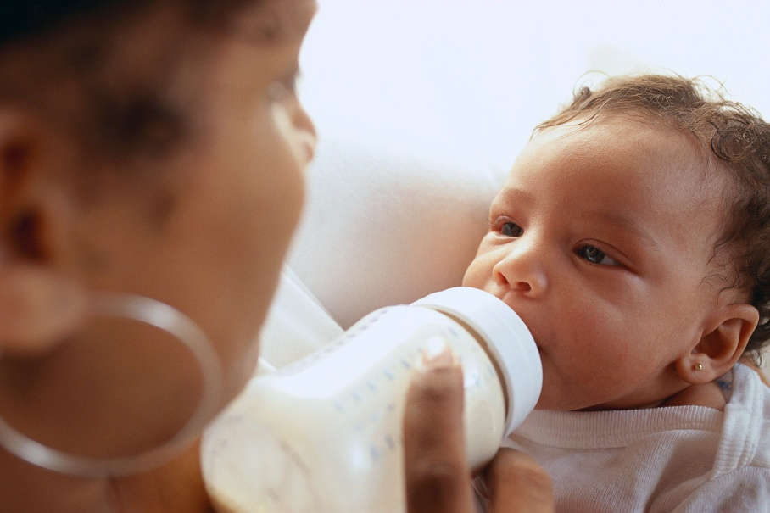
Being The Best caregiver you can
WE unknowingly carry our mothers and
Fathers inside of us.

Slide 40
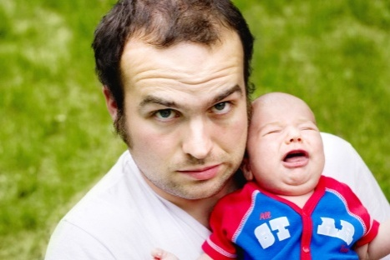

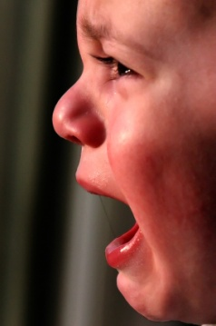


the worst parent is in there too
WE unknowingly carry our mothers and Fathers inside of us.

Slide 41



Most of us are in the middle
Mostly Loved, Valued, Secure, and Worthy
Mostly Rejected, Un-loveable, Unworthy and Repulsive

Slide 42
forming relationships self and other
Being Mothered
Unconscious Self Concept
Child Expresses Need
Unconscious Response to Child
Child Reacts to Mother’s Emotional Tone

Slide 43
forming relationships self and other
Mother Feels Success Or Failure
Mother Responds Emotionally
Child Reacts To Mother’s Emotions
Relationship Is Set In A Direction
Attachment or Abuse or Neglect

Slide 44
forming relationships self and other
Early Experiences of Nurturing, Love Warmth
Security and Self-Confidence Grow
Child Expresses Need
Mother Responds in Nurturing Way
Child Calms or Child Learns

Slide 45
forming relationships self and other
Mother Feels Success
Success Increases Confidence
Child Feels Secure
Trusting Relationship
Strong Attachment Between Mother and Child

Slide 46
When working with a child who has trauma
Early Experiences of Nurturing, Love Warmth
Security and Self-Confidence Grow
Child Expresses Need
Mother Responds in Nurturing Way
Illness
Stress
Trauma
Child Continues In Distress

Slide 47
When working with a child who has trauma
Mother Confidence Decreases
In Home Worker Supports
Insecurity Enters – Mother Feels Anxiety
Child Feels Anxiety – Distress Increases
Frustration Builds
Distance or Abuse

Slide 48
When working from a past experience with trauma
Early Experiences Rejection
Unconscious Insecurity
Child Expresses Need
Mother Responds with Anxiety and Doubt
Child Continues In Distress
In Home Worker Support Parent

Slide 49
When working from a past experience with trauma
Mother Feels Like Failure
In Home Worker Support
Projects Failure on to Child
Sees Child As Her Mother Saw Her
Child Reacts to Rejection/ Anger/Anxiety
Distance or Abuse

Slide 50
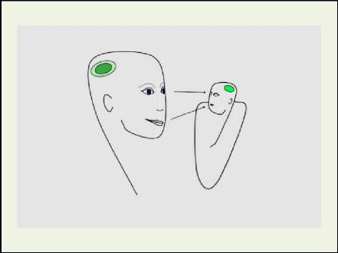
Relational Basis of brain development
“The neural systems which mediate social
interaction, communication, empathy and the
capacity to bond with others are all shaped by the
nature, quantity and timing of
early life
relationships.”
Bruce Perry

Slide 51
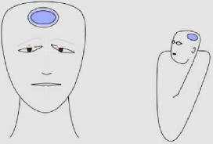
Relational Basis of brain development – Depressed Caregiver

Slide 52
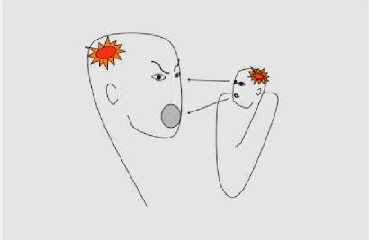
Relational Basis of brain development – Abusive or angry caregiver

Slide 53
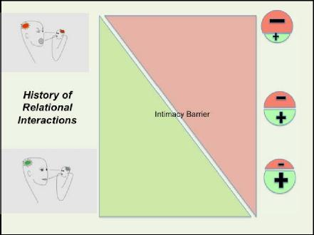
How early experiences affect current relationships

Slide 54
Relational Effects
Intimacy Barrier
Degree of Relational Damage
Out
IN
Formal Casual Interaction Friendship Intimacy

Slide 55
Relational Effects
Reacts with defensiveness when he/she feels someone is crossing intimacy barrier.
Expects rejection from others.
Attempts to control intimacy by keeping others at a distance or controlling interactions to decrease anxiety.

Slide 56
Relational Effects
Symptoms you may see:
Unlikable Child
Poor Social Skills
Inability to Share
Controlling Behaviors
Social Withdrawal
No Friends
Can’t Keep Friends
Has trouble seeing the other person’s side of things.
Sees to be unaware of how other’s feel.
Seems inconsiderate.
Doesn’t get how others see him.
Negative Peer Group

Slide 57
Relational Issues – case example
Nyrene is an 11 year old girl with RAD.
Tantrums are frequent and severe.
Responding to intimacy barrier with grace and patience is the key to healing.

Slide 58
Relational Issues – case example
Attachment activities produced both good and bad.
Decrease in tantrums and school issues.
Increase in personal attacks.

Slide 59
Measured Doses of Attachment Related and developmentally appropriate interactions
Expect Set Backs and Whiplash
Younger Children (3 to 9)
Singing and rhythmic games (Itsy Bitsy Spider – Wheels on the Bus)
Cooking together (smashing and mashing)
Water activities (washing hair, dishes, baby clothes)
Sensorial activities (smelling and touching games)
Hand massage

Slide 60
Measured Doses of Attachment Related and developmentally appropriate interactions
Expect Set Backs and Whiplash
Older Children (10 to 18)
Dancing together
Yoga together
Cooking together (smashing and mashing)
Sensorial activities (smelling and touching activities)
Hand or foot massage

Slide 61
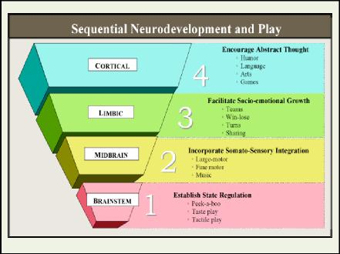
Addressing Regulation Problems
Means Addressing the Limbic Brain
Abstract Thought:
Language Based
Art
Games
Social Emotional
Teams & Win-Lose
Sharing
Turns
Somato-Sensory Integration
Large motor
Fine Motor
Music
Static Regulation
Peek-a-boo
Taste Play
Tactile Play

Slide 62
Helping children Extend
Relational Healing
Practice social skills with adults first, when mastered try with one child
Short time periods
Structure
Non-shaming feedback
In the moment work

Slide 63
Helping children with Relational Effects
Practice skills in one to one situations
Decrease the amount of time in social situations.
Recognize that they will need down time after social situations.
Tap on the shoulder and whisper direction or hints.
Reminders ahead of time.
Make social skills a project that you and the child will work on together.
Set up small group or special needs accommodations
for child in any group activity.

Slide 64
Web sites for images
https://www.dfps.state.tx.us/Training/Trauma_Informed_Care/images/photo_page22.jpg
http://www.genvievhypnosis.com/sites/default/files/images/BrainDev.jpg

